Slide 1
How to write an Application Letter and Curriculum Vitae

Slide 2
RESUME
or
Curriculum Vitae (CV)

Slide 3
The standard form of resume in Europe consist of 6 parts:
Personal information (details) : The employer wants to know who are you and how to contact you. Put only essential information.
Education: write from you are in and give the necessary information about you name and address of your school/ lyceum /gymnasium.

Slide 4
Work experience: If you have had any summer or Saturday jobs, describe them.
Position of responsibility: If you don’t have work experience, this section can show employers you potential. Write what conference you’ve been to, what project you’ve done and what competitions you’ve taken part in.
Skills: Indicate what you are good at ( for example, language, computers, maths, ect).
Interests: You should stress about your interests. Don’t just list your interests; add a few details.

Slide 5
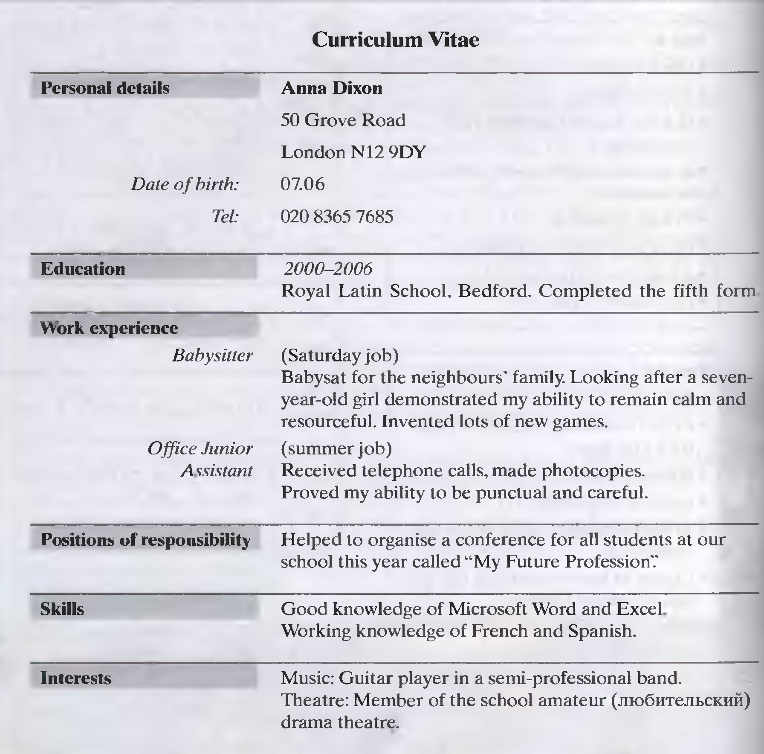

Slide 6
A letter of application (письмо работодателю)
1.Your full address and e-mail.( Адрес и электронная почта)
2. The … or the name of the person who you are writing to and the name of the organization. ( Должность или имя человека, которому вы пишите)

Slide 7
3. The greeting ( приветствие): Dear Sir/ Madam if you don`t know name.( Уважаемый сэр/ мадам, есливы не знаете имени)
Dear Mr/ Mrs/ Ms and the surname if you know.( Уважаемый мистер/мисс/ миссис и фамилия , если знаете)

Slide 8
4. Paragraph 1 mentions where you hear ( know) about the vacancy and names the job you are applying for. ( Абзац 1 упоминает, откуда вы узнали о вакансии и наименование работы, по поводу которой вы обращаетесь)
5. Paragraph 2 presents you to the employer, explains why you are suitable for the position. (Абзац 2 представляет вас работодателю и объясняет, почему вы подходите на это место)

Slide 9
6. Paragraph 3 mentions your previous work experience ( if any), skills and abilities that make you suitable for the job and suggests ways of getting in touch with you. (Абзац 3 упоминает ваш предыдущий опыт работы, если есть, умения и способности, которые делают вас подходящими для работы и предлагает способы контакта с вами)

Slide 10
7. The ending ( окончание): Yours faithfully if you don`t know the person’s name. Yours sincerely if you know.( Преданный Вам, если вы не знаете имени работодателя. Искренне Ваш, если знаете)
8. Your signature. ( Ваша подпись)
9. Your full name printed underneath. ( Ваше полное имя печатными буквами)

Slide 11
A letter of application ( образец письма)
35 Gorky Street,
Vladimir 600 199
e-mail: alex@vladnet.ru
15th May 2002
The Manager,
Happy Pizza Restaurant,
5 New Square,
Vladimir 600 007
Dear Sir/ Madam, _________________________

Slide 12
I am writing in reply to your advertisement in our local newspaper Vladimir Novosty for salespeople to work in your new outlet.
At the moment I am a third-year student at Vladimir Teacher Training College studying English and Spanish. I would like to work for you in order to experience. At first hand, an organization which has western roots but has developed for the last decade very successfully in Russia. I have been impressed by the service provided by your staff. I am hoping that I shall now have a chance to help give this sort of service to other customers.

Slide 13
Apart from helping on the farms in my home village at harvest time, I have had no real work experience yet, but from my farm work I know how to work in a team. However, I hope that you will be kind enough to give me an interview so that I can explain myself better. I have also given my e-mail address above so that you can contract me that way if you wish.
I am enclosing my CV for your consideration.
I look forward to hearing from you.
Yours faithfully, __________________
Alexander Popov ________________

Slide 14
1. Relevant skills or knowledge 2. Reasons for applying for the job. 3. Particular points in the CV that show experience is relevant. 4. Why he is writing the letter. 5. Reference to the CV enclosed.
Put the information in the correct order.

Slide 15
1. Write all the necessary personal information at the top. 2. Write the name of your secondary school and any examination results. 3. Write any responsibilities you have now or had in the past at school. 4. List any work experience you may have had and when you did it. 5. Think of any interests you have outside school. Write the name of at least one referee. It can be one of your teachers, or someone who knows you well.
Writing tip
Planning and writing a CV

Slide 16
Plan Dear Sir/Madam, Introduction (Paragraph 1) explain why you are writing Main Body (Paragraph 2) your reasons for wanting the job (Paragraph 3) some brief reference to your interests, skills and experience which may suggest that you are suitable for the job Conclusion (Paragraph 4) closing remarks Yours faithfully, (your signature) (your full name)

Slide 17
HOMEWORK: Write your CV and a letter of application. You are going to apply for one of the jobs in this advertisement. Use the plan, the writing tip, Alex`s letter and the CV on page 162 (ex23) in your text book as a model. (100-120 words)

